Slide 1
Group 25 - Smart Garden Monitoring System
Client - N/A
Advisor - Diane Rover
Notes:
Sarah

Slide 2
Team Members - Roles
Sarah Schoenke - Client Interaction/Communication Lead
Bryanna Adamson - Team Organization Lead
Julia Condon - Application Design/Frontend Lead
Jasen Helsel - Testing/IoT Lead
Devon Sindt - Embedded Systems Lead
Jake Thomae - Assistant Embedded Systems
Nick Vaughan - AGILE/Backend Lead
Notes:
Everyone

Slide 3
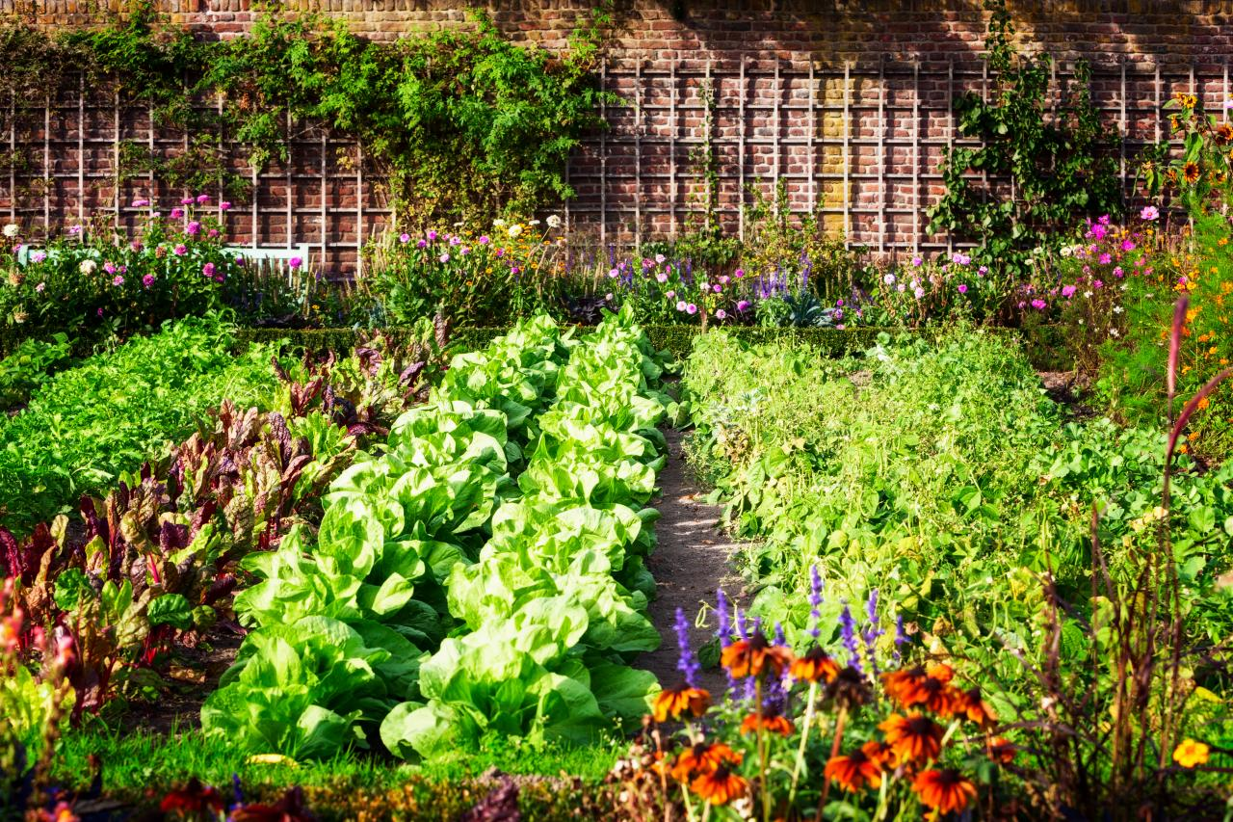
Project Vision
Goal: Economical and efficient system
to grow and monitor produce
Target Group:
Students
Hobby gardeners
Food insecure communities
Use Cases
Healthier food options
Grow plants in comfortable space
Track/monitor different aspects of plant growth
Display and adjust crucial information
Notes:
Bryanna
Improve life of:
Students - Low income group, long term cheaper way to grow food
Food insecure communities - Guaranteed source of food where isn’t common

Slide 4
Requirements
Functional Requirements
Monitor temperature of the environment
Water plant at timed intervals
UV lighting at timed intervals
Non-functional
Maintainability
Ease of Use
Reliability
Constraints
Must cost under $1000
Fit in a small apartment or dorm
Notes:
Bryanna

Slide 5
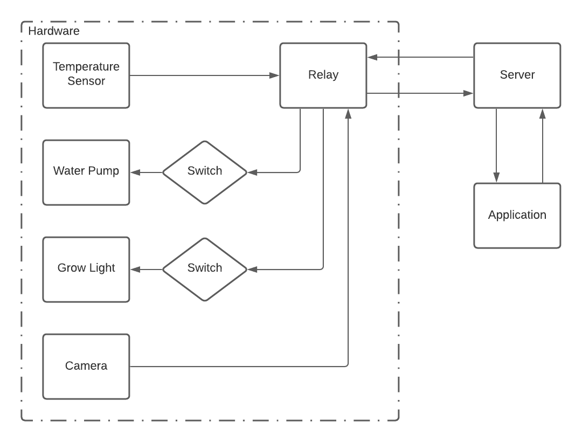
Conceptual/Visual Sketch
Target clients
Low cost, consumers
What makes our design unique?
Bring it all together
Control
MCU
Notes:
Julia

Slide 6
System Design
Functional decomposition
Main functionality of project
Physical design layout
Plant enclosure
Component layout
Notes:
Jasen

Slide 7
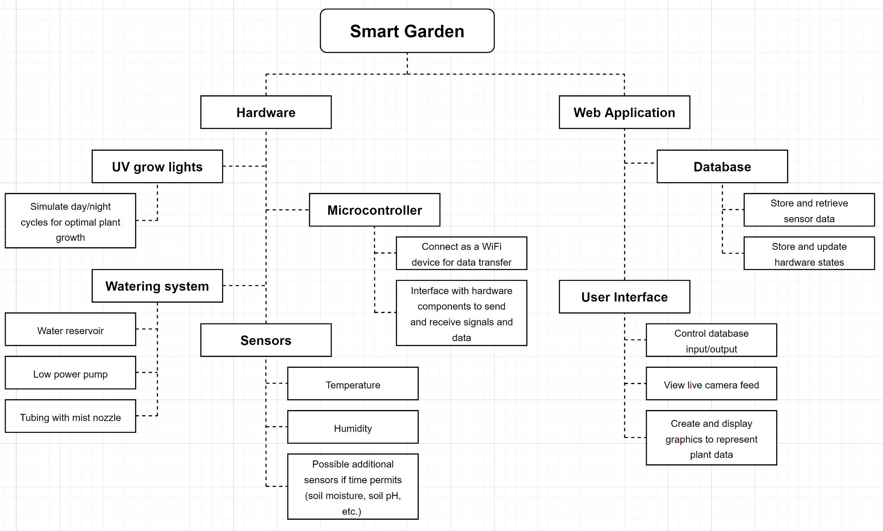
Functional Decomposition

Slide 8
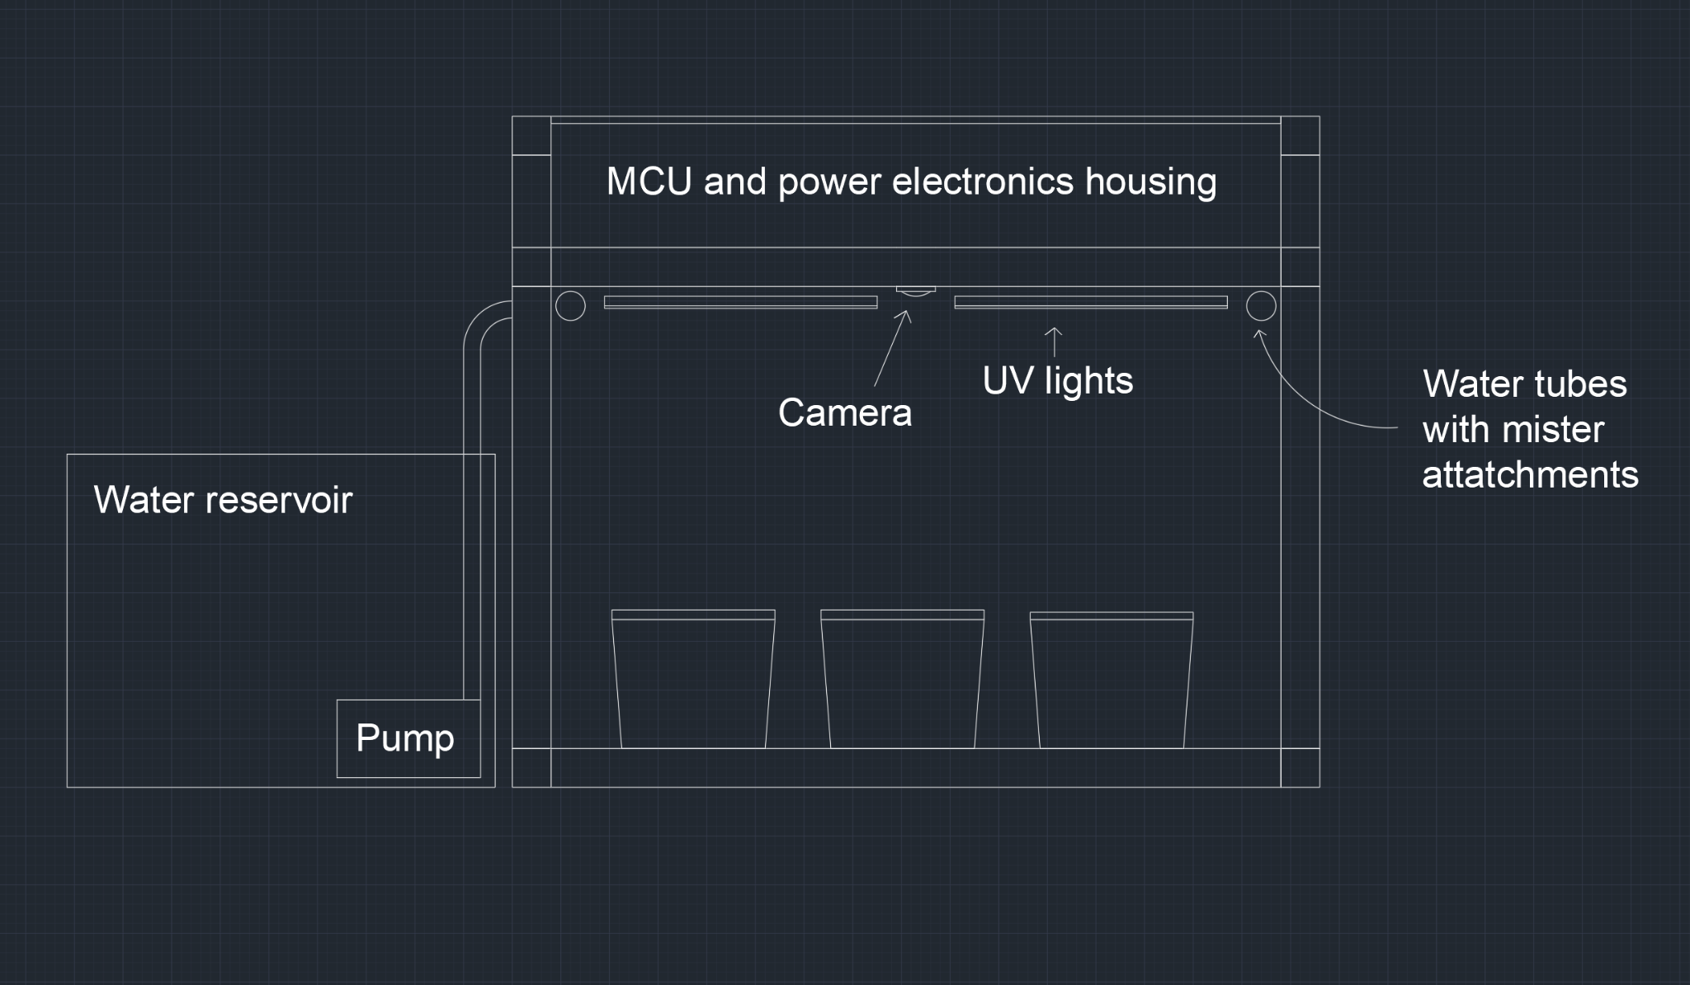
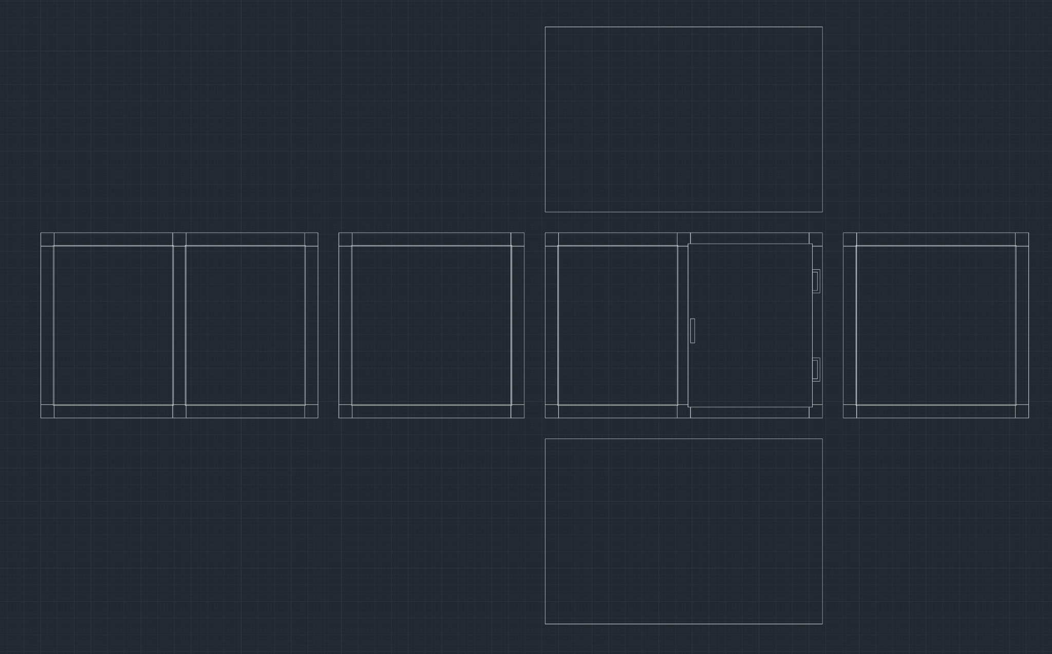
Physical Design
Notes:
Jasen

Slide 9
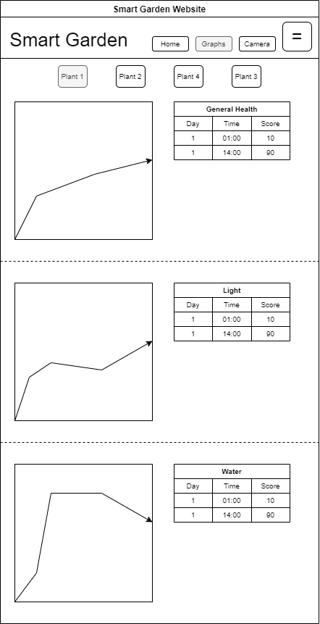
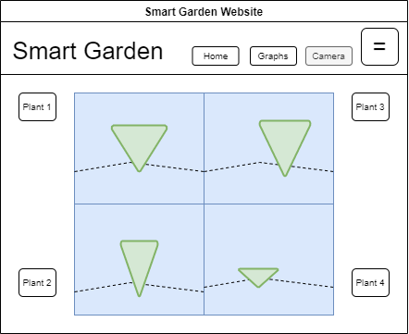
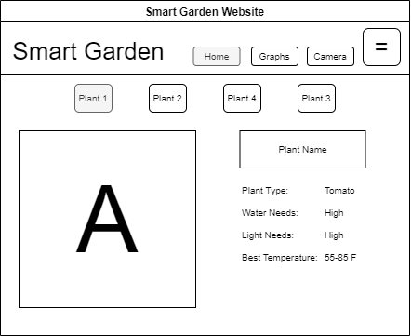
Frontend Design
Notes:
Julia
Home:
Tab for each plant
plant name (custom)
System presets based on type of plant
Graphs
raw data
Score based on
Light
Water
Temperature
Humidity
grade based on a 100 pt scale
Camera
displays live feed of your plants

Slide 10
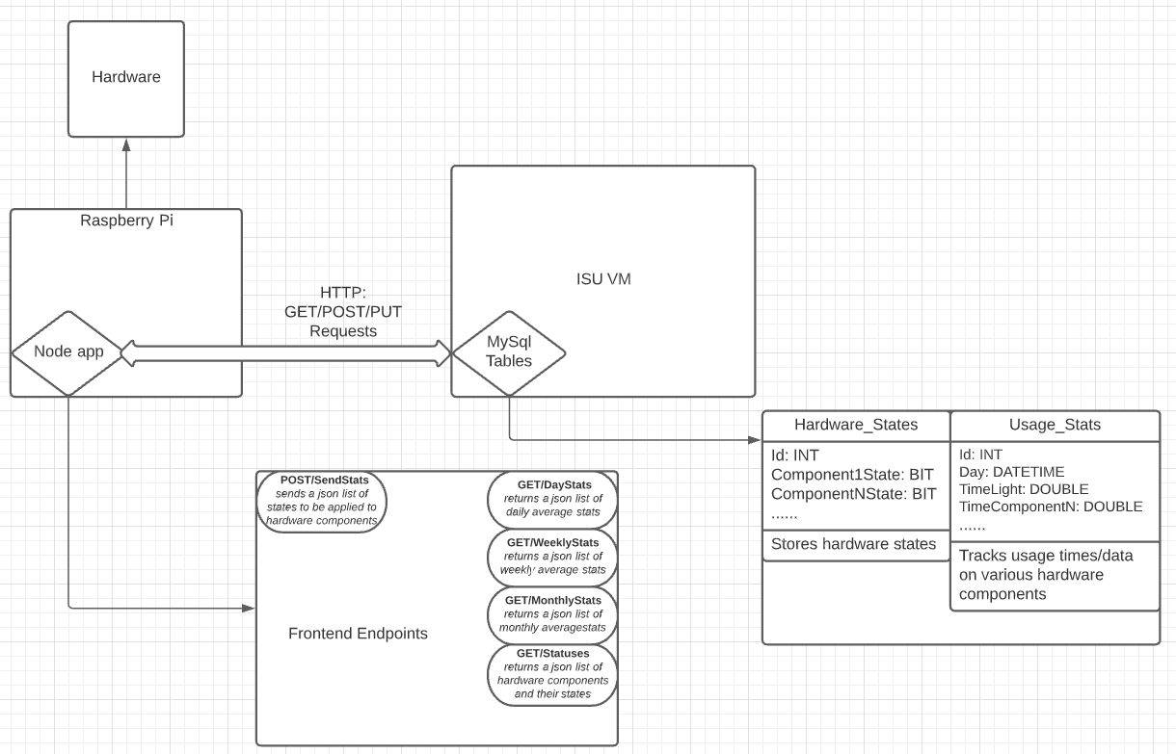
Backend Design
ISU VM
Hosts Frontend & SQL
Node.js app
Raspberry Pi Hosted
PUT/POST → Frontend status changes
Sends to Hardware
GET → Frontend stats
GET → Hardware states
MySql
Usage tables
States tables
Notes:
Nick

Slide 11
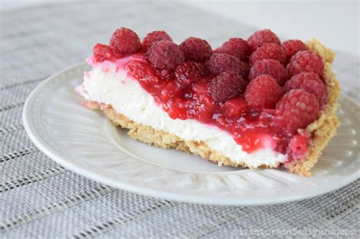
Embedded Systems Design
Raspberry Pie (mMmm tasty)
Camera
Misc
Notes:
Devon

Slide 12
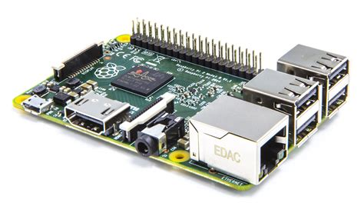
Embedded Systems Design
Raspberry Pi (not so tasty ☹️)
Camera
Misc
Notes:
Devon

Slide 13
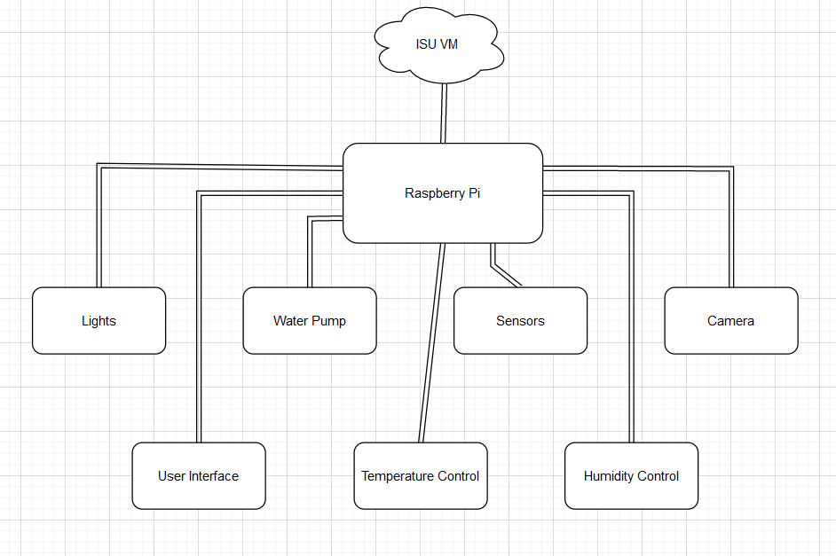
Prototype Implementations
Currently in the process of ordering parts
Notes:
Devon

Slide 14
Design Complexity
What makes your design difficult/unique?
Taking real world data and transferring it to a web application
Needs to yield actual results
Takes weeks to see if it is successful, and weeks more to do more than 1 test
What kind of design iterations were needed?
Initially had a more complex microprocessor, and utilized an IKEA cabinet
Decided to simplify to a lower cost/simpler model
Notes:
Jake

Slide 15
Project Plan
Any market survey or other quantitative/qualitative assessment of need
Nebullam, automated gardening and produce delivery
food insecurity is very common in America (10.5% of US population is food insecure – US department of Agriculture)
Notes:
Jake

Slide 16
Project Plan
Tasks
Determining hardware/software requirements
Cost analysis
Creating proposal presentation
Risks and mitigation plan (potentially task-wise)
Tasks above do not have high risk at all
Most of project is low risk
Mitigation plan usually includes replacement and reinforcement

Slide 17
Project Plan – Schedule/Milestones
Metrics (Progress Tracking)
Physical
Modification towards hardware or the greenhouse itself
Software
Connectivity with other components
Modularity & Testability
Big Milestones
Physical completion of the greenhouse
Backend → Hardware connectivity
Frontend → Backend connectivity
Project Completion
Notes:
Nick

Slide 18
Project Plan – Schedule/Milestones
Notes:
Nick

Slide 19
Test Plan
Agile Testing
Test hardware and software as features come out
Regression Testing
Test all features every 3 weeks during meeting
Acceptance
Work as expected
light functionality
misters
Connection between software and hardware
Plant growth
Tracking Growth - Height
different plants
Notes:
Sarah -

Slide 20
Conclusions
Where are you in your schedule?
Finish order parts -> winter break
Next semester’s plans
January:
Cabinet Creation
Software design
Notes:
Sarah -

Slide 21
Conclusions
Individual team members Semester Plan:
Sarah: Communication Lead. Work with Julia help with the creation front end website, and help with connection of backend to frontend.
Jake: Work with Devon to design and implement electrical hardware/embedded software.
Jasen: Set up communication protocols between hardware and software using WiFi. Lead testing in the second half of the semester.
Nick: Leading the creation of the backend of the web application. Make sure sprint tasks stay on track
Devon: Work with Jake to design and implement electrical hardware/embedded software.
Bryanna: Team Organization Lead. Working with Julia on frontend design
Julia: Leading the creation of the frontend of the website
Notes:
Sarah -

Slide 22
Thank you!

